Slide 1
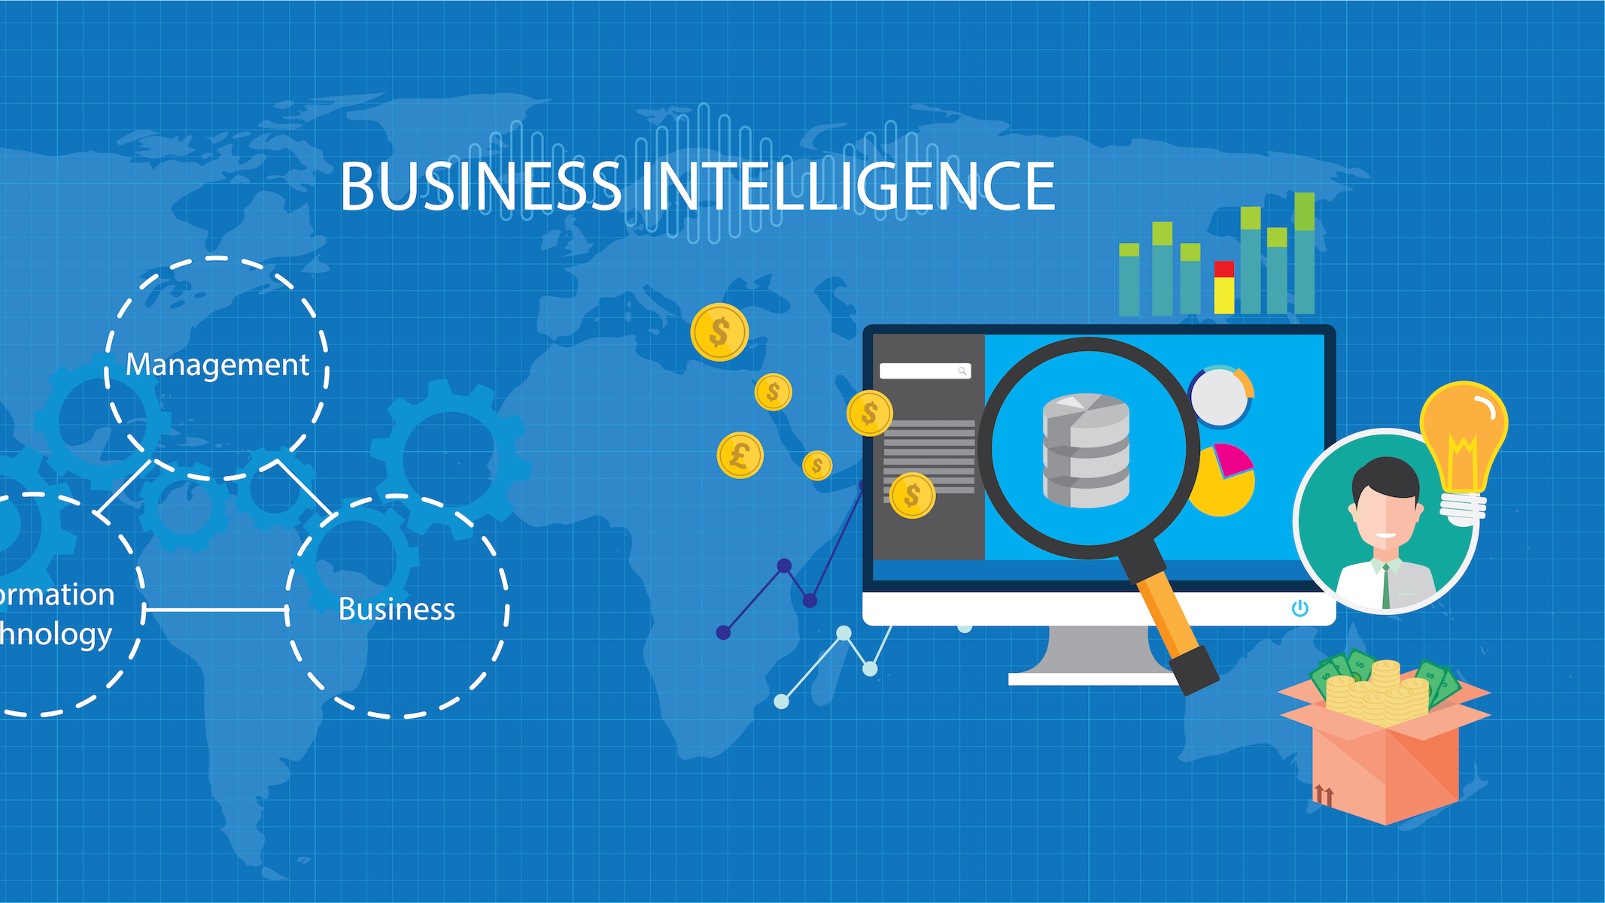
Submitted by: Maram Alassaf
This Photo by Unknown author is licensed under CC BY-SA-NC.

Slide 2
What is Business intelligence
With the use of technology, business intelligence (BI) analyzes data and produces insights that can be utilized, thus assisting managers, employees, and executives in making well-informed decisions. It means getting information from both external and internal systems, preparing it for analysis, and producing dashboards, reports, and visualizations. The ability of business users to base operational and strategic decisions on analytical findings is made possible by these technologies.[2] Through a methodical process, unprocessed data is converted into useful insight that helps businesses make better decisions and run more efficiently both strategically and operationally. [1]. Furthermore, business intelligence is a wide concept that includes the use of descriptive analytics, process analysis, performance benchmarking, and data mining.[3]
In order to analyze business KPIs and get useful insights for my project, I used PowerBI software combined with the LinkedIn Job Postings data. LinkedIn's overall performance is improved and its tactical and operational procedures are optimized with the help of this analysis.
Notes:
[1] IBM. (n.d.). Business Intelligence. Retrieved from: https://www.ibm.com/topics/business-intelligence
[2] "Business intelligence (BI)." TechTarget. Available at: https://www.techtarget.com/searchbusinessanalytics/definition/business-intelligence-BI
[3] Frankenfield, J. (2022). How Business Intelligence (BI) Works. [online] Investopedia. Available at: https://www.investopedia.com/terms/b/business-intelligence-bi.asp.
‌

Slide 3
Tools
Tools:
Spreadsheets: mostly employed for tabular data organization, analysis, and presentation. Examples: Microsoft Excel(LinkedIn Job Posting data set) or Google Sheets
Reporting Software: utilized to gather, process, and display data in an organized manner. Examples: PowerBI, Tableau.
Data Visualization Software: designed to produce graphical displays of data to help in understanding and decision-making. Examples: Tableau, Power BI, and Qlik.
Online Analytical Processing (OLAP): allow users to perform multidimensional analysis of data, enabling interactive exploration and examination of information from various angles and perspectives.
For the tools I used in my project are Microsoft Excel (where the LinkedIn Job Posting data was stored), and PowerBI (which I employed to produce an insightful analysis of the data).
Notes:
[1] Frankenfield, J. (2022). How Business Intelligence (BI) Works. [online] Investopedia. Available at: https://www.investopedia.com/terms/b/business-intelligence-bi.asp.
‌

Slide 4
Techniques
Techniques:
Data mining: entails examining huge data sets within an organization to find patterns and significant information. Data mining in business intelligence assists in finding hidden trends and making decisions.
Data visualization: is the process of presenting data in graphical or visual representations that make complicated data more accessible and intelligible, allowing stakeholders to immediately grasp insights and patterns. For instance, in my dashboard, I've made comparative analysis, contribution analysis, correlation analysis, and distribution analysis.
Data modeling and analytics: This approach entails developing models to analyze data, forecast future trends, and make suggestions. In BI, data modeling and analytics allow firms to study historical data, forecast outcomes, and make educated strategic decisions based on predictive insights.
Quering: Database queries are information requests that allow BI system users to access and analyze data sources. In the BI application that I have made, I used DAX queries to extract and combine columns from different tables to create a new table that contains new information. Furthermore, DAX was used to create new measure that represents new data
Notes:
[1] Misiuro, A. (2022). What are the business intelligence techniques: a quick overview. Available at: https://synder.com/blog/what-are-the-basic-business-intelligence-techniques/.
[2] What Is Business Intelligence? (With Techniques And Uses) | Indeed.com India

Slide 5
Critical Review of the Newly Designed BI Application for LinkedIn
For User Recruitment:
The new BI application aims to enhance LinkedIn's job posting statistics in order to assist user needs. Recruiters may improve their listings by using the specific analytics it provides on job posting performance, including views, applications, and engagement rates. To improve their job posting methods, users can also make use of trend and comparison analysis features, which enable them to identify patterns over time and compare their performance to industry norms. Also, users can interact with the newly designed application by changing the filter of the company size. Also, for user requirements the dashboard should be user-friendly, function-friendly, organized dashboard.
For Business Recruitment:
The application enhances recruiting decisions from a business perspective. It establishes important user demographics for targeted advertising, enhances job postings with data-driven insights, and evaluates the return on investment for sponsored content and job postings. These features, which assist companies in reaching a more appropriate audience, enhancing hiring procedures, and validating advertising efforts, boost LinkedIn's overall performance in talent acquisition.
The dashboard should be meaningful and help the business to extract meaningful insights from it.
Notes:
[1] The new BI application improves LinkedIn's job posting analytics by providing detailed info like views, applications, and engagement rates, helping recruiters optimize listings. Users can refine strategies with trend analysis and comparison features to enhance job posting effectiveness.
[2] the application improves recruiting decisions by analyzing user demographics for targeted advertising, optimizing job postings with data-driven insights. These capabilities enhance LinkedIn's talent acquisition performance.

Slide 6
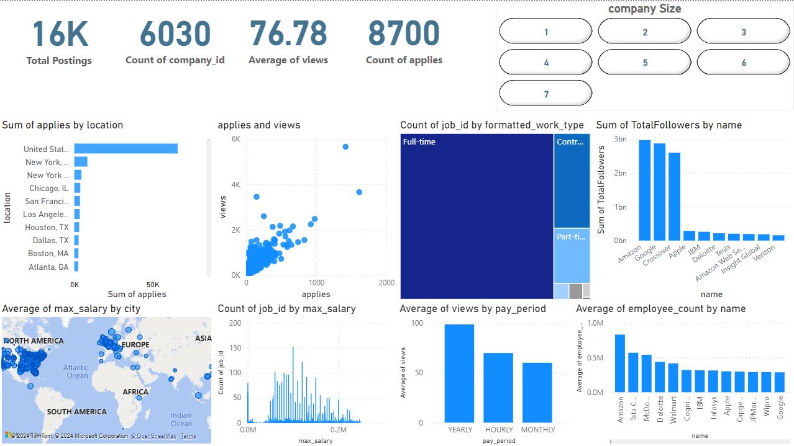
The Designed Dashboard

Slide 7
Critical Review of the Dashboard for LinkedIn-Job Postings
The dashboard contains different elements and adjustments aimed at improving its functionality, which include the following:
The Cards: The card indicators located in the top left corner provide a summary of the current status of job postings. Total Job Postings that are on LinkedIn, this means that both companies and employees are active on LinkedIn to find a job, and I used the DAX measure for this card. Total Number of Companies, This indicates the total count of companies that have active job postings on LinkedIn. The Average of Views, This metric indicates the overall interest in the job postings. Total Applies, It provides a summary of the overall interaction from potential candidates with the job listings.
Bar Charts
The first bar chart is a horizontal is for the Sum of Applies by Location, which represent the total number of applications submitted for job postings on LinkedIn, categorized by location.
The second vertical bar chart is for the Average Views by Pay Period, which reveals how different pay periods (yearly, monthly, hourly) affect the average number of views for job postings on LinkedIn. It provides valuable insight into which pay structures attract more attention from potential candidates.
The third vertical bar chart which is generated using DAX Average Employees by Company Name, , reveals the average number of employees at companies posting jobs on LinkedIn. This insight helps identify which companies, by size, are most actively recruiting.

Slide 8
Critical Review of the Newly Designed BI Application for LinkedIn
The dashboard contains different elements and adjustments aimed at improving its functionality, which include the following:
The Distribution Analysis, in my BI application I used the Histogram for the Count of Job ID by Max Salary, which visually segments job opportunities by salary ranges, showing prevalent and scarce categories. This analysis not only reveals distribution patterns but also provides insights into demand trends and salary expectations, making it crucial for understanding LinkedIn's job posting landscape. It helps in strategic recruitment decisions, salary benchmarking, and assessing market competitiveness.
Another Distribution Analysis, in my BI application I utilized the Scatter plot for the Number of Views and Applies, which reveals correlations between job views and applications, assesses posting efficiency in converting views to applications, and evaluates overall posting strategy effectiveness.
The Contribution Analysis, I used a Tree map between the Job ID and the Formatted Work Type for LinkedIn job postings, which can easily allow us to see how different Jobs there are across work types e.g.(full-time, part-time, and contract). This shows which jobs are more frequent in specific types of work setups, helping in planning hiring and allocating resources according to demand in different job categories.
The Contribution Analysis, I used a Donut Chart between the Job ID by Formatted Experience Level, which allows us to quickly understand which experience levels have the highest or lowest number of job postings, identifying potential trends. It helps in strategic decision-making regarding recruitment efforts, resource allocation for training or hiring, and understanding the competitiveness of various experience levels in the job market based on LinkedIn data.
To represent the Geographic Data for the Average of Max Salary by city I used a Map, It highlights cities with higher salaries, offering insights into regional salary trends and helping job seekers and employers make informed decisions about salary expectations and job locations.
Lastly, I used a Slicer for Company Size, The Slicer for Company Size allows you to filter job posting data by company size, helping identify which sizes of companies are most active in posting jobs. allows for a detailed analysis of how job postings are distributed across different company sizes.

Slide 9
How business intelligence tools can contribute to effective decision-making
Insightful Reporting: BI tools generate detailed reports that offer valuable insights into revenue, sales, inventory, and historical performance, helping in understanding current business dynamics.
Data Visualization: BI tools simplify complex data sets by presenting them in graphics, facilitating informed decision-making.
Benchmarking and Improvement: BI tools make it easier to measure performance in relation to standards in the industry, pinpointing problem areas and recommending improvements.
Data-Driven Decision-Making: By delivering accurate, data-backed reports from historical and real-time data, replacing guesswork with factual analysis.
Operational Streamlining: BI In order to improve overall business performance, tools automate jobs and optimize processes, reducing waste and expediting the delivery of products.
Notes:
[1] Chopra, Y. (2021). 10 Brilliant Ways Advanced BI Tools Help in Decision Making. [online] DataToBiz. Available at: https://www.datatobiz.com/blog/advanced-bi-tools-help-in-decision-making/.
‌

Slide 10
Examples of organizations that have used business intelligence tools
Bugcrowd is a cybersecurity platform that connects its customers to security researchers to identify vulnerabilities in products and applications. BI helped Bugcrowd by centralizing interaction data and enabling deep understanding of customer behavior. This allowed Bugcrowd to improve customer retention through proactive problem-solving and targeted upselling opportunities, ultimately driving negative churn and fostering a high-touch customer service approach. (Atlassian, n.d.).
Business Intelligence (BI) transformed New York Shipping Exchange (NYSHEX) by centralizing data from multiple sources into a single system, granting universal access across the company. This empowered non-technical staff to perform detailed data analysis independently. As a result, NYSHEX significantly increased shipping volumes between Asia and the U.S. in 2019, demonstrating the impact of BI on enhancing company performance and efficiency. (Morris, 2021).
BI enabled Expedia to enhance customer satisfaction by analyzing extensive customer data, aligning insights with strategic objectives. This facilitated real-time monitoring of customer experience KPIs, empowering teams to take immediate corrective actions. BI also assisted travel management and other departments in optimizing operations by identifying unused tickets and offline bookings, thereby improving cost-saving strategies. (Morris, 2021).
Tesla utilizes business intelligence to wirelessly connect their vehicles to corporate offices, facilitating data collection for analysis. This integration enhances customer connectivity, enables proactive issue resolution such as component damage and road conditions, resulting in improved customer satisfaction and informed decision-making for future upgrades and products. (Morris, 2021).
Notes:
[1] Atlassian (n.d.). 7 Real-World Examples of Business Intelligence. [online] Atlassian. Available at: https://www.atlassian.com/data/business-intelligence/7-real-world-use-cases#:~:text=7%20real-world%20examples%20of%20business%20intelligence%20in%20use.
‌[2] Morris, A. (2021). 23 Examples of Business Intelligence. [online] Oracle NetSuite. Available at: https://www.netsuite.com/portal/resource/articles/business-strategy/business-intelligence-examples.shtml.
‌

Slide 11
Legal issues should be examined when leveraging business intelligence tools
The key legal considerations for leveraging BI tools securely.
Data Privacy and Security: BI tools aggregate data from various sources into one system, increasing susceptibility to breaches. Implementing strong security measures like encryption, access controls, and audit trails is crucial to prevent unauthorized access and adhere to data privacy laws such as GDPR or CCPA.
Regulatory Compliance: Industries like healthcare and finance are subject to stringent regulations (e.g., HIPAA, Sarbanes-Oxley) governing data handling and analysis. Businesses using BI tools must ensure compliance with these regulations to manage sensitive data appropriately.
Intellectual Property Protection: Developing or integrating BI tools involves managing intellectual property risks. This includes obtaining proper licenses for third-party software and protecting proprietary BI innovations through patents or trademarks.
Liability and Risk Management: Implementing BI tools shifts liability risks, especially if decisions rely on inaccurate BI-generated reports or privacy breaches occur due to surveillance. Clearly defining roles and responsibilities for BI tool usage and establishing safeguards are essential to mitigate legal risks.
Employee Data Handling: Businesses must establish clear policies for managing employee personal data within BI tools. Transparency in data collection, processing, and usage is essential to comply with data protection laws and foster trust among employees regarding BI tool usage.
Notes:
[1] Knowledge and Science Bulletin Board System. (2023). Top 8 Legal Issues to Consider When Implementing Business Intelligence Tools. [online] Available at: https://www.knbbs.com/top-8-legal-issues-to-consider-when-implementing-business-intelligence-tools/
‌

Slide 12
How organizations could use business intelligence to extend their target audience
Businesses can use Business Intelligence (BI) to find sales possibilities by keeping an eye on consumer spending patterns and modifying their pricing tactics to reach a wider market.
BI contributes to client retention by monitoring transactions and encouraging proactive engagement to uphold loyalty.
BI raises operational efficiency by cutting waste and simplifying inventory management.
Business Intelligence (BI) facilitates data-driven decision-making, revealing latent patterns and boosting competitiveness.
Notes:
‌

Slide 13
How organizations could use business intelligence to extend their target audience and make them more competitive within the market
Optimizes management of supplies
Cuts unnecessary spending
Offers transparent financial information for well-informed decision-making
Improves market competitiveness
Reduces IT constraints
Ensures accurate reporting
Boosts operational efficiency
Enables prompt reactions to market changes
Reveals hidden trends
Helps firms seize new opportunities
Ensures strategic and efficient business processes with comprehensive data access
Notes:
‌

Slide 14
How organizations could use business intelligence to extend their target audience and make them more competitive within the market taking security legislation into consideration.
Data Privacy Compliance: By putting in place transparent data policies and upholding consumer rights, make sure BI practices abide by the CCPA and GDPR.
Measures for Data Security: Employ anonymization, access controls, and encryption to safeguard confidential data and reduce the chance of a data breach.
Ethical Data Usage: Prevent biases in business intelligence models, appropriately handle user consents, and guarantee equitable treatment for all clientele.
Responsibility and Openness: To guarantee that data collection is required and retention periods are suitable, keep thorough audit trails and engage in data minimization practices.
Frequent Audits and Reviews: To guarantee continuous adherence to data protection regulations, conduct routine audits of business intelligence procedures and work with IT and legal teams.
Notes:
‌

Slide 15
Thank You
Maram Alassaf
21110197
Section 6
Notes:
[1] Knowledge and Science Bulletin Board System. (2023). Top 8 Legal Issues to Consider When Implementing Business Intelligence Tools. [online] Available at: https://www.knbbs.com/top-8-legal-issues-to-consider-when-implementing-business-intelligence-tools/
‌

